Slide 1
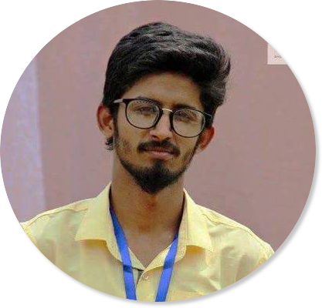
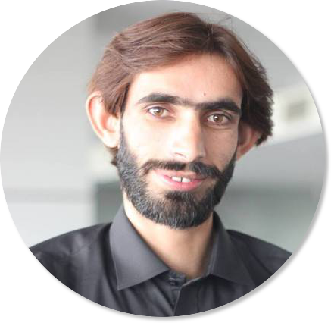
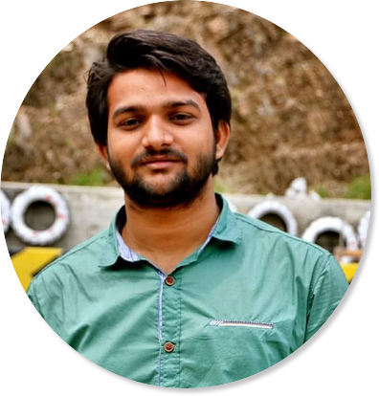
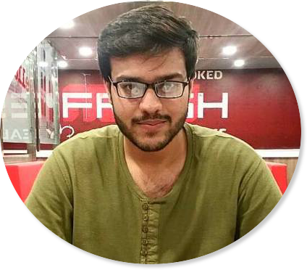
Team Evelander
Anas Khalid Kiyani
BSCS13030
Mohabbat Ali Sial
BSCS13049
Muhammad Ahmer
BSCS13036
Hajir Abdul Rehman
BSCS13027

Slide 2
Problem
Everyday, an event happens around the people and most of them don’t get any notification or any detail about that event. It’s in loss both for the event organizers and attendees. There isn’t any specific event related portal.

Slide 3
Additional Interviews

Slide 4
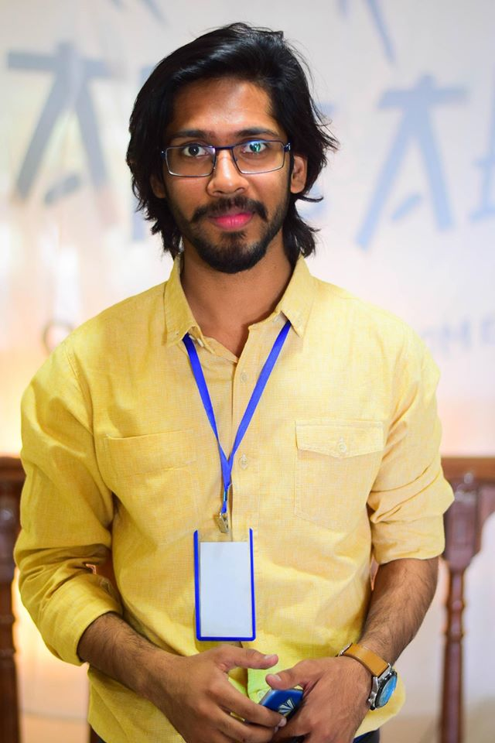
Interviewee 1
Name: Kabeer Afzal Khan
Reason for interview: He is President of an adventure society and leading organizer of Barsalego at FAST Fsd.
Place of interview: At his place
Method of recruitment :Contacted via Phone

Slide 5
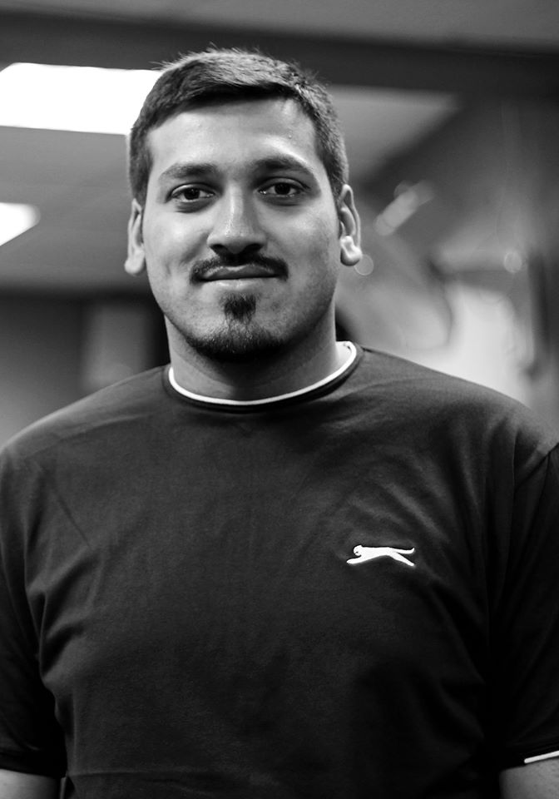
Interviewee 2
Name: Ahmad Islam
Reason for interview: He is Assistant Manager Operations at Plan9 and do market and manage events
Place of Interview: Plan9 office
Method of recruitment: Contacted via email

Slide 6
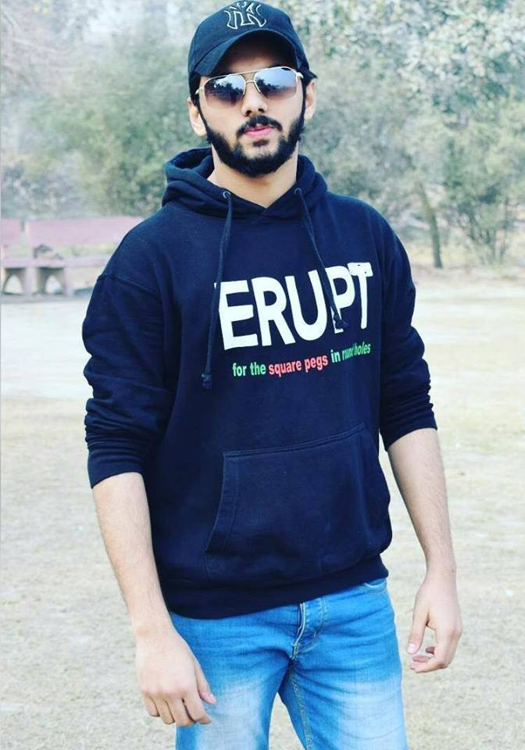
Interviewee 3
Name: Muhammad Zohaib Qureshi
Reason for interview: He is an enthusiast wander boy. Attends many events.
Place of interview: ITU
Method of recruitment: Contacted via phone

Slide 7
POV 1
We met: Kabeer Afzal Khan who is the President of FAST Fsd Adventure Society and leading Organizer of Barsalego FAST Fsd.
We were amazed: to know that most event organizers use Facebook and it isn’t that good for organizers.
It would be game changing: if one can exactly know how many people are interested and actually coming to the event.

Slide 8
POV 2
We met: Ahmad Islam, who is Assistant Manager Operations at Plan9, the largest incubation center of Pakistan. He frequently organize and market events of Plan9
We were amazed: to know that there are people who are interested to go to an event but missed details of the event because they are infrequent users of Facebook.
It would be game changing: to notify every active and passive user individually.

Slide 9
POV 3
We met: Muhammad Zohaib Qureshi, who is an enthusiast and go to events very frequently.
We were amazed: to know that in many cases attendees came to know about the cancellation of event when they reached the venue. It is also very difficult to contact with the organizer on Facebook.
It would be game changing: if we can make communication between organizers and attendees easier.

Slide 10
HMW’s
HMW have a way to let people connect with the event scheduling and updates?
HMW have a platform to minimize the marketing budget and maximize the target market?
HMW make the events more secure and verified?

Slide 11
EVELANDER
Evelander is an app that takes care of events around
you and every detail about events you are most
interested in. You can register online and get notifications
as your favorite event gets near.

Slide 12
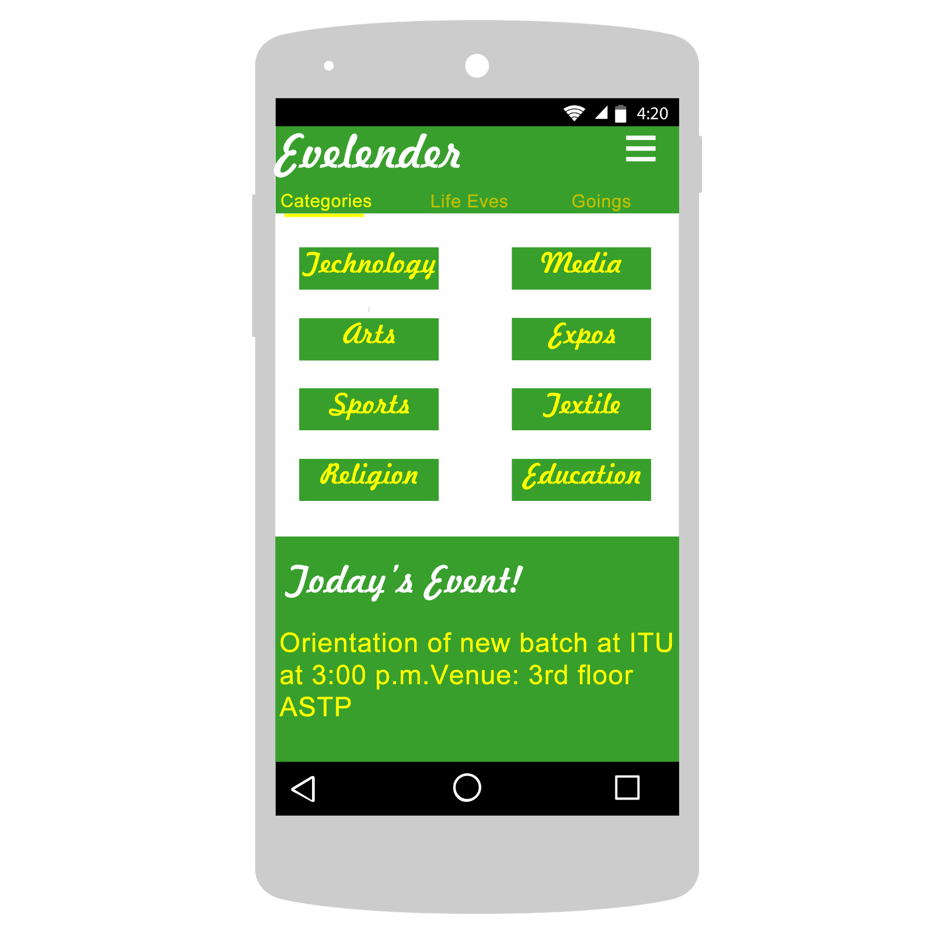

Slide 13
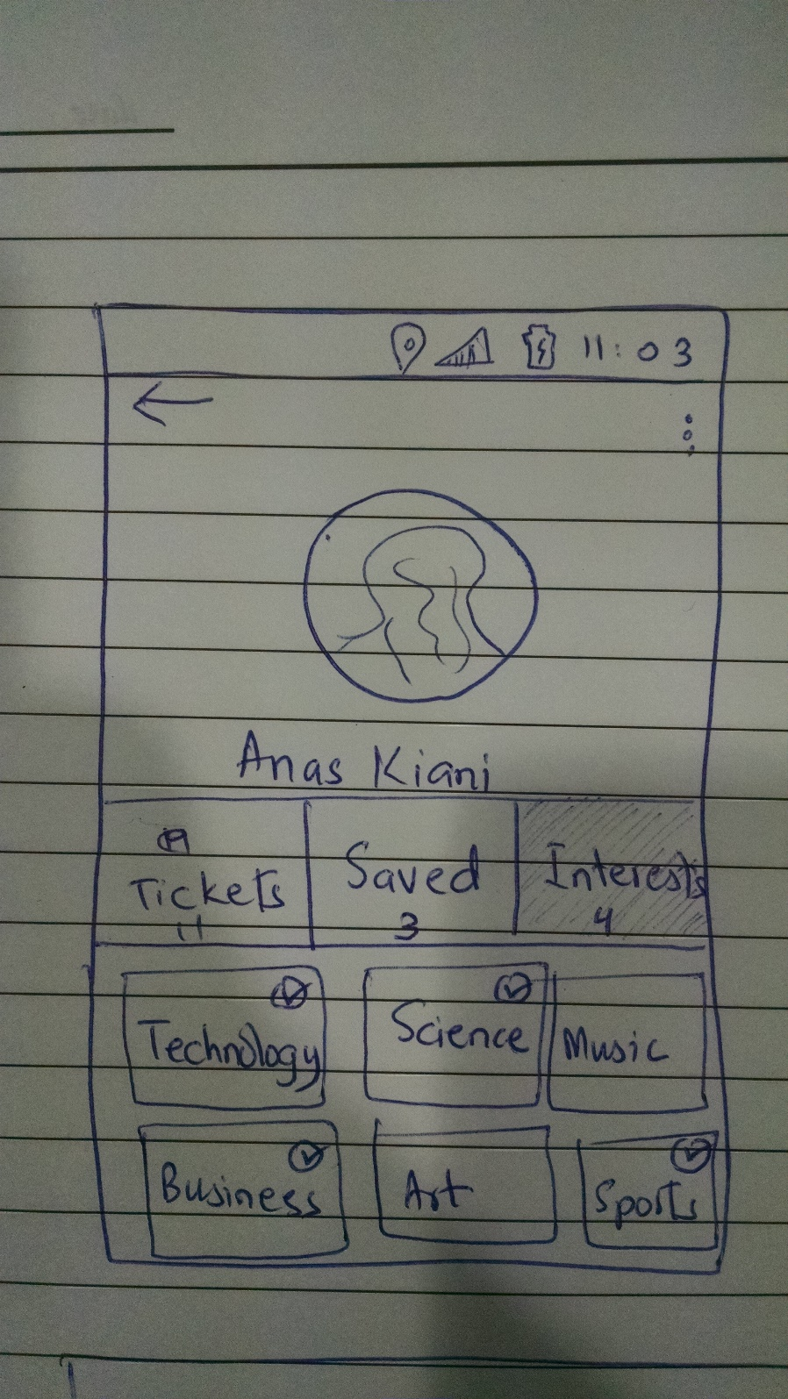
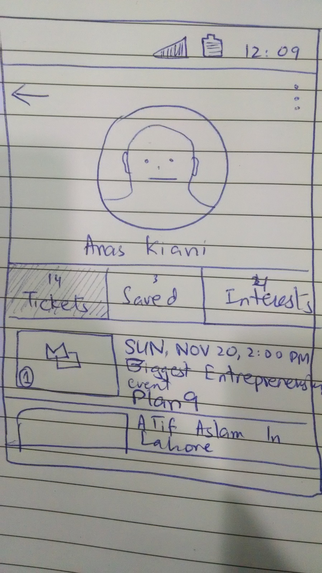

Slide 14
Thank You

